Slide 1



CSCI- 6660- 01 Intro to Artificial Intelligence Project
C nnect
4
Presented by
Pavan teja Sripati
Navya Vemireddy
Komal Tankashala

Slide 2
What is Connect 4 game?
Table of contents
Game representation Winning Model Winning Strategy Task Environment State representation
AI in Connect Four — Implementing Minimax Conclusion

Slide 3

What is connect 4?
▶ Connect 4 is a zero-sum game, which means one party wins everything or both parties win nothing; there is no “mutual” win or loss, but there can be ties, as that would qualify as both parties winning nothing.
▶ The game board is made up of seven columns and six rows that are vertically suspended.
▶ The players take turns dropping their colored tokens into the grid, with the pieces falling straight down and occupying the lowest available space within the column.
▶ The objective of the game is to be the first player to create a horizontal, vertical, or diagonal line of four of their own-colored tokens.
▶ The game requires strategy and planning to block your opponent's moves and create opportunities for your own tokens to connect.

Slide 4
Connect 4
A board, s, represented by a 7x6 multidimensional array, where x = row and y = column of s and where (x, y) = {X, O} is won when one of the following are true:
1. (x, y) = (x, y+1) = (x, y+2) = (x, y+3)
2. (x, y) = (x + 1, y) = (x + 2, y) = (x + 3, y)
3. (x, y) = (x + 1, y+1) = (x + 2, y+2) = (y+3x + 3, )

Slide 5
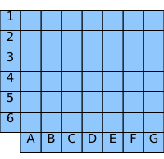
Game Representation

Slide 6
Horizontal Winning model

Slide 7
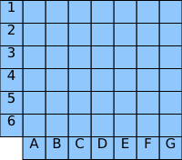
Vertical Winning model

Slide 8
Diagonal Winning model

Slide 9
Winning Strategy 1
Place in the middle column

Slide 10
Winning Strategy 2
Makes trap for the opponent

Slide 11
Winning Strategy 3
Make a 7

Slide 12
Task environments
Task Environment | Connect 4 game
Fully / Partially observable | Fully observable
Single / Multi agent | Multi agent
Deterministic / Stochastic | Deterministic
Episodic / Sequential | Sequential
Static / Dynamic | Static
Discrete / Continuous | Discrete

Slide 13
State representation
Total squares – 7 * 6 = 42
Player1 (yellow), player2 (red), Blank - b
Possible states – 4531985219092 (over 4 trillion)
Non-terminal states – 2626652048471 – over 2 trillion (Play on)
Terminal states – 1905333170621 – nearly 2 trillion (Game over)
According to Numberphile video,2013
S. Edelkamp and P. Kissman

Slide 14
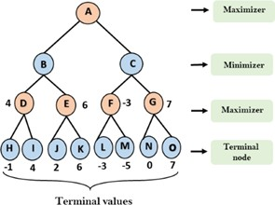
MinMax
▶ Player 1: Maximize score
▶ Player 2: Minimize score
▶ Explores each possible move within the “game tree”
▶ Recursive
O(b^d)
b= # of possible moves
d= max # of turns until end game (depth)

Slide 15
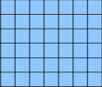
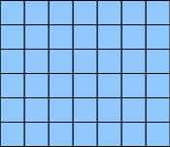

AI in Connect Four — Implementing MinMax
Initial phase of Game

Slide 16


Heuristic MinMax
The Heuristic function for connect 4 minimax is given by
H = (X4 * 1000 + X3 * 100 + X2 * 10) - (Y4 * 1000 + Y3 * 100 + Y2 * 10)
X4 – four yellow coins in a row X3 – Three yellow coins in a row X2 – Two yellow coins in a row
Y4 – four red coins in a row Y3 – Three red coins in a row Y2 – Two red coins in a row
Board score = 80
X = Player Y = Player

Slide 17
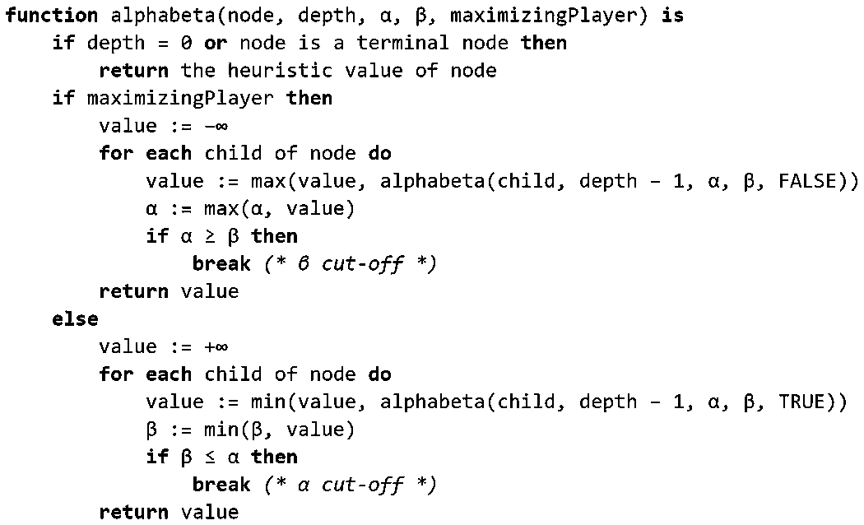
Pseudo code

Slide 18
Conclusion
The project utilizes a minimax algorithm for optimal move selection, which allows the AI player to outperform human players by considering all possible moves.
Tuning the number of depths in the minimax function can have a significant impact on the AI player's performance, with lower depths potentially leading to worse results.
Despite this, the strategy and algorithm used in the project have been successful in delivering impressive results.

Slide 19
THANK YOU

